Slide 1
Srikari Gadivemula
-Final project

Slide 2
Project Title :
AIML in IOT
Artificial Intelligence (AI), in at least one of its various forms, has had an impact on all major industries in the world today. AI has been growing rapidly in the past few years, as there have been several advancements in data collection, analysis and processing . The key contributors to these advancements are robust Internet of Things (IOT) connectivity and high-speed processors to fortify it.

Slide 3
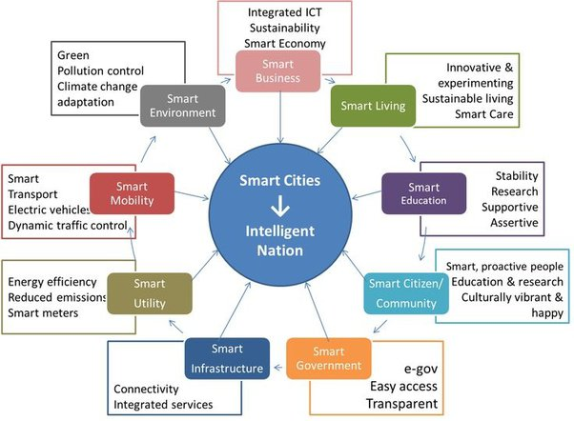
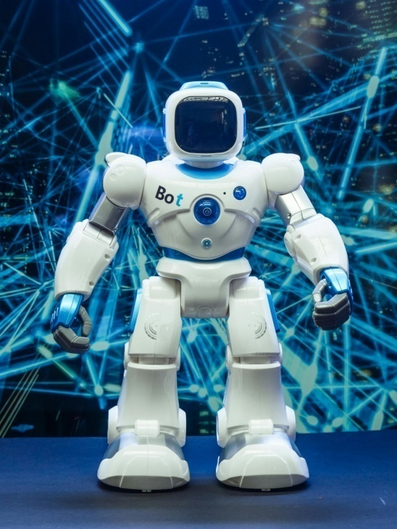

Slide 4
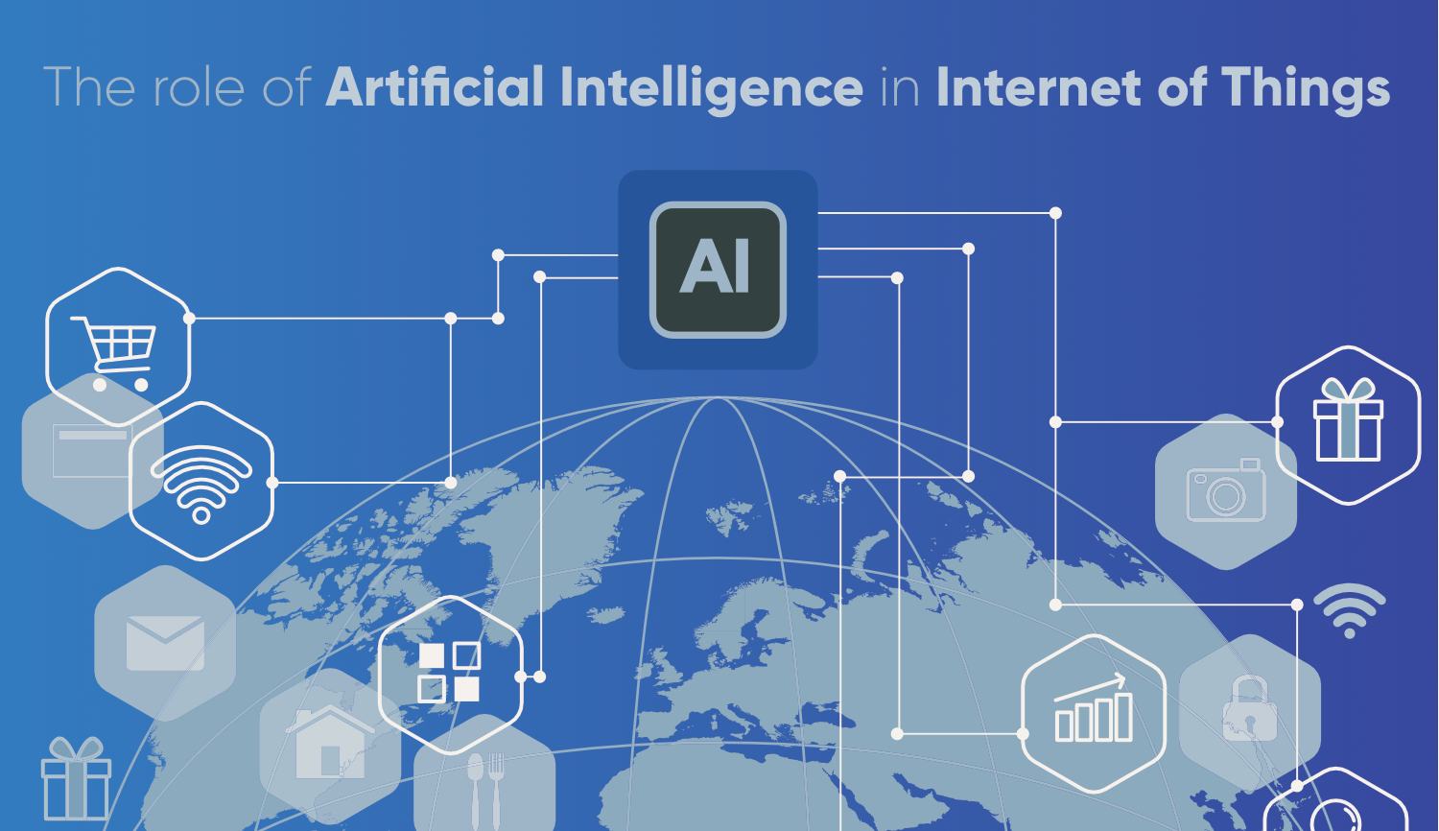
Role of AI in IOT :

Slide 5
Use of AI in IOT :
AI can be used to improve the efficiency of IOT networks by optimising data transmission and reducing network congestion. By analysing network traffic in real-time, AI can identify the most efficient routes for data transmission, reducing latency and improving overall network performance.

Slide 6
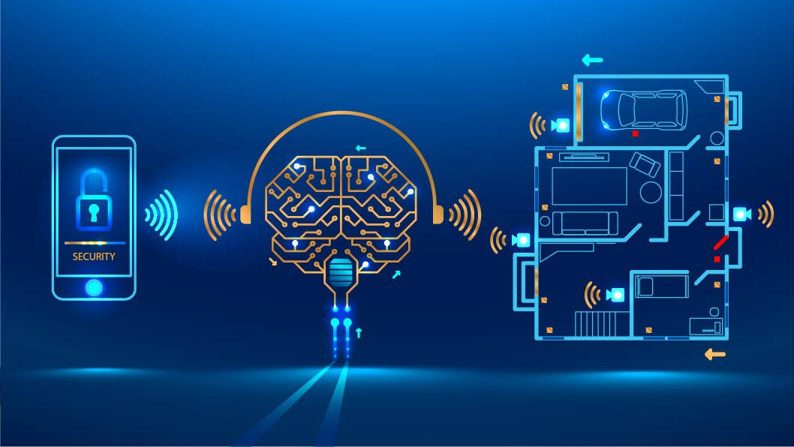
chat development
Data and insights

Slide 7
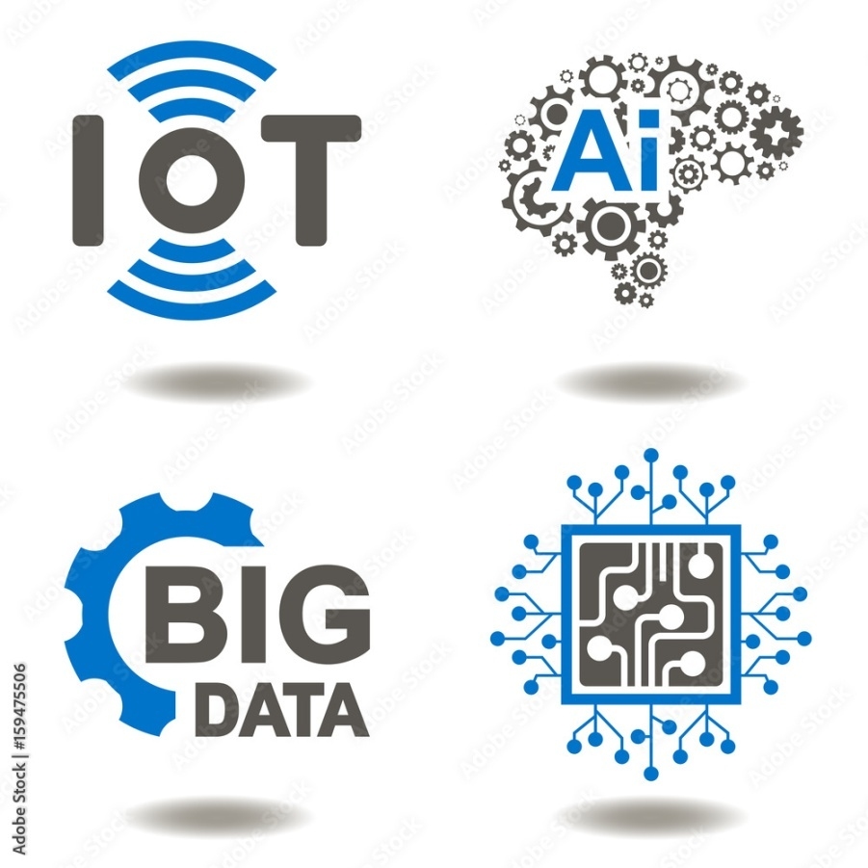
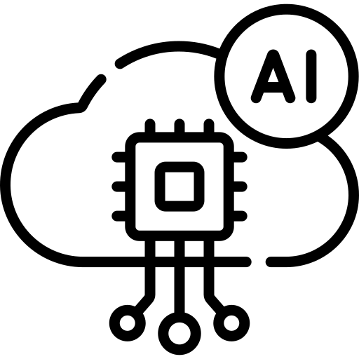
AI is becoming increasingly important in the Internet of Things (IOT) ecosystem because it can help to extract insights from the vast amounts of data generated by connected devices. AI can enable IOT devices to learn from their environment and make decisions based on that learning, without human intervention

Slide 8
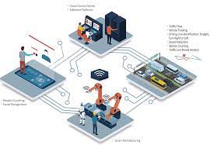
IOT devices collect all data and transmit it to the cloud or other internet-connected storage locations. Furthermore, AI serves as the brain of IOT, aiding in decision-making and enabling machines to perform tasks autonomously.
The most well-known implementations of AI in IOT security devices include smart locks or access systems, often with built-in facial or recognition. The market of AI in C cyber Security is also closely connected to IOT.

